Slide 1
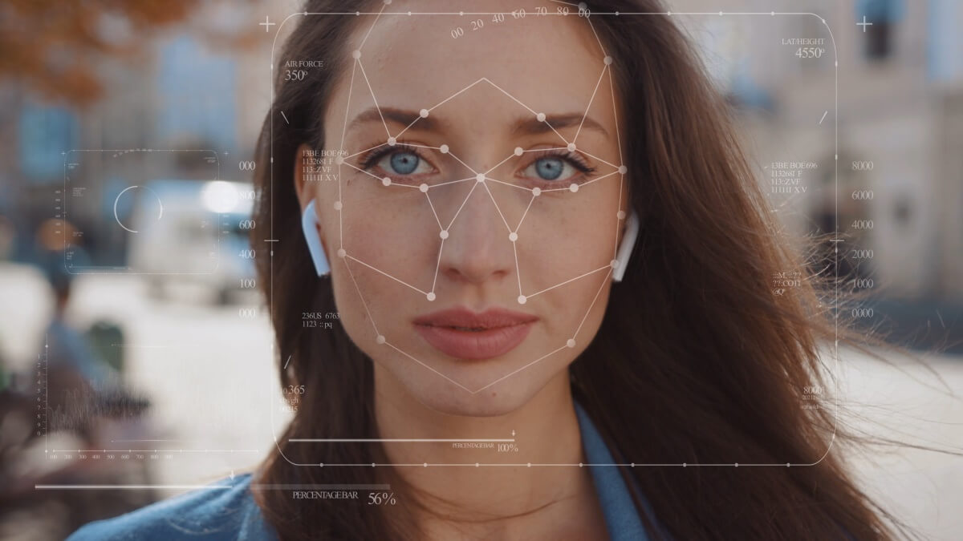
Deepfake Image Detection using CNN
Omme Symon | Tamanna Kawser Chowdhury | Tanima Khair
Notes:
Drag & drop to add a picture in the back placeholder

Slide 2
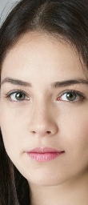
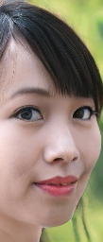
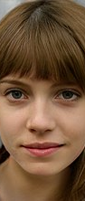
AI Generated Images
Notes:
Drag & drop to add a picture in each placeholder

Slide 3
INTRODUCTION
In today’s digital era, creating and changing images has become extremely advanced, leading to the rise of fake images that look real. Deepfakes, using advanced technology like StyleGAN, create convincing but false content. Our research focuses on detecting these deepfakes to protect against misinformation and maintain digital integrity.
Notes:
Drag & drop to add a picture in the placeholder

Slide 4
PROBLEM STATEMENT
Creating convincing fake images is easier than ever before.
Fake images, especially deepfakes, look extremely realistic.
Differentiating between real and fake images is challenging.
Deepfakes use sophisticated technology, specifically GANs.
GANs employ two neural networks to generate and refine fake images.

Slide 5
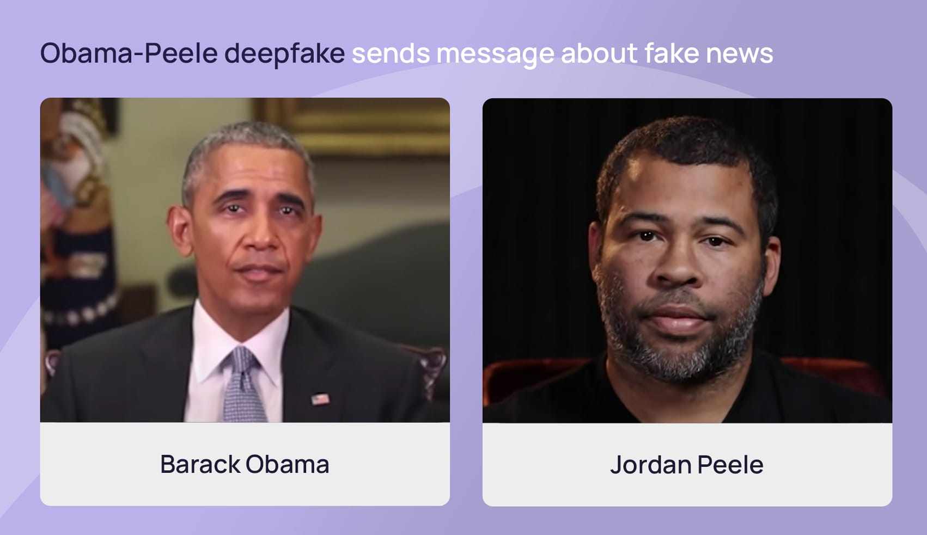
MOTIVATION
01
Barack Obama
02
Rashmika Mandanna
03
Arup Fraud Case

Slide 6
OBJECTIVES
Objective 1
Objective 2
Develop robust and reliable methods for detecting deepfake images using Convolutional Neural Networks (CNNs).
Develop and test deep learning algorithms to detect StyleGAN-generated images.
Objective 3
Objective 4
Improve the accuracy and effectiveness of deepfake detection methods.
Contribute to safeguarding digital content integrity and reducing risks associated with deepfake technology.
Objective 5
Prevent misuse of deepfakes in practical scenarios.

Slide 7
CONTRIBUTION
We developed CNN-based methods to detect StyleGAN-generated deepfake images with high accuracy. Our models, CNN1 and CNN2, achieved rates of 94.07% and 91.75% respectively, ensuring effective identification and mitigation of deepfake risks in digital content.
Notes:
Drag & drop to add a picture in the placeholder

Slide 8
LITERATURE REVIEW
2024
1
Model: GAN-CNN
Dataset: Kaggle Real and Fake Face Detection
Accuracy: 70.08%
2023
2
Model: Hybrid CNN-LSTM Model Based on Transfer Learning
Dataset: DFDC, Ciplab
Accuracy: 98.21% (DFDC), 97.81% (Ciplab)
2022
3
Model: CNN and RNN with PSO Algorithm
Dataset: DFDC, Celeb-DF
Accuracy: 94.2% (DFDC), 97.26% (Celeb-DF)
2021
4
Model: GAN based CNN
Dataset: Indian Actor Images Dataset
Accuracy: 96.35%
2020

Slide 9
LITERATURE REVIEW
2024
5
Model: D-CNN
Dataset: CelebA, FFHQ, GDWCT, AttGAN, STARGAN, StyleGAN, StyleGAN2
Accuracy: 97.2 %
2023
6
Model: DFP
Dataset: Photoshopped real and fake faces
Accuracy: 94%
2022
7
Model: Convolutional Vision Transformer (CViT)
Dataset: DeepFake Detection Challenge Dataset (DFDC)
Accuracy: 91.5%
2021
8
Model: CNN-based model with manual distillation extraction and dynamic thresholding
Dataset: DFDC, Celeb-DF v2
Accuracy: 94.2%(Celeb-DF v2), 93.75%(DFDC)
2020
9
Model: Convolutional Trace (CT) Fingerprinting
Dataset: Image dataset created by 10 different GAN architectures
Accuracy: 98%(Overall Classification Accuracy), 93%(FACEAPP)

Slide 10
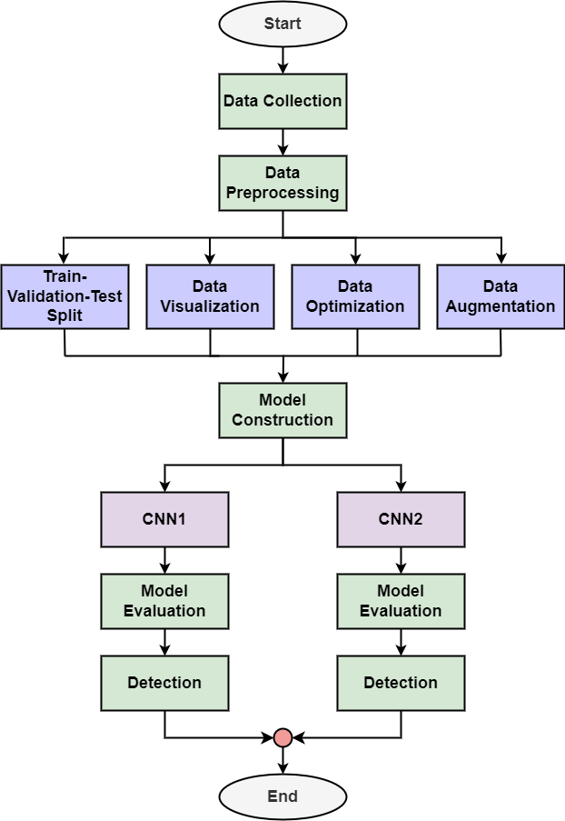
Methodology
Figure 1: Overall Working Process of Deepfake Image Detection Using CNN
Notes:
Drag & drop to add a picture in the placeholder

Slide 11
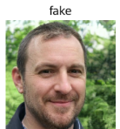
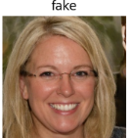
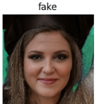


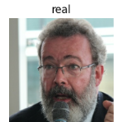
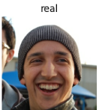
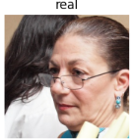
Methodology (Cont.)
Data Collection
Source: Kaggle
Dataset: 140k Real and Fake Faces
Fake Faces: 70000 (StyleGAN)
Real Faces: 70000 (Flickr)
Resized: 256 x 256 pixels
Division: Training, Validation, and Testing
(a)
(b)
Figure 2: Images from Dataset, (a) Fake, (b) Real
Notes:
Drag & drop to add a picture in the placeholder

Slide 12
Methodology (Cont.)
Train-Validation-Test Split
01
02
03
Train
Validation
Test
5008 fake images
5008 real images
1254 fake images
1254 real images
1263 fake images
1263 real images

Slide 13
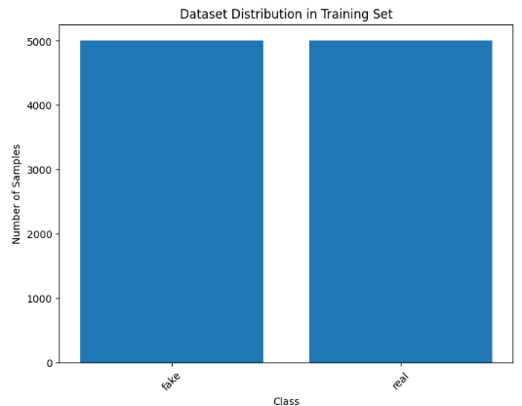
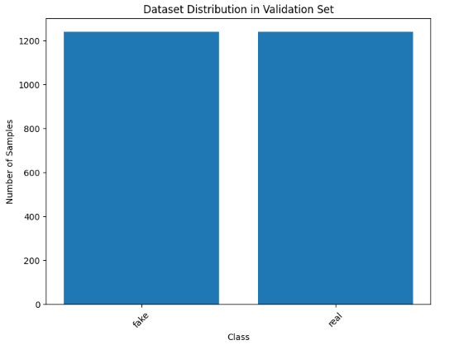
Methodology (Cont.)
Data Visualization
Figure 3: Dataset Distribution in Training Set
Figure 4: Dataset Distribution in Validation Set
13
Notes:
Drag & drop to add a picture in each placeholder

Slide 14
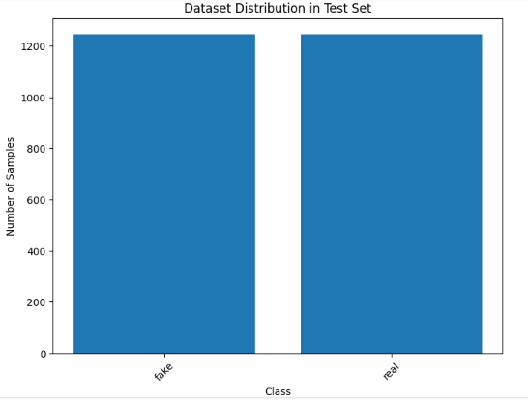
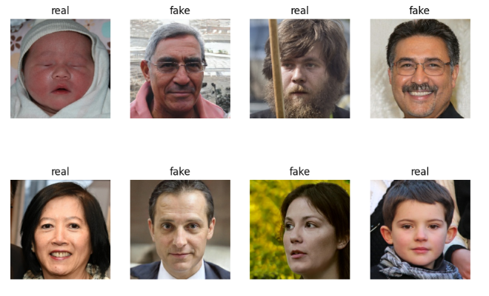
Methodology (Cont.)
Data Visualization (Cont.)
Figure 5: Dataset Distribution in Test Set
Figure 6: Some Fake and Real Images of Training Set
14
Notes:
Drag & drop to add a picture in each placeholder

Slide 15
Methodology (Cont.)
Data Optimization
01
02
03
Caching
Shuffling
Prefetching
Storing in memory or on disk
Randomizing order of examples
Fetching data batches ahead of time

Slide 16
Methodology (Cont.)
Data Augmentation
Table 1: Data Augmentation Techniques and Parameters.
Techniques | Parameters
Resize | (256,256)
Rescale | (1. /255)
Random Flip | Horizontal and Vertical
Random Rotation | 0.2
Random Crop | (224, 224)
Sobel Edges | N/A
16
Notes:
Drag & drop to add a picture in each placeholder

Slide 17
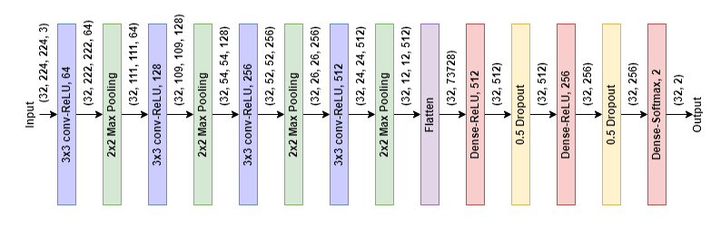
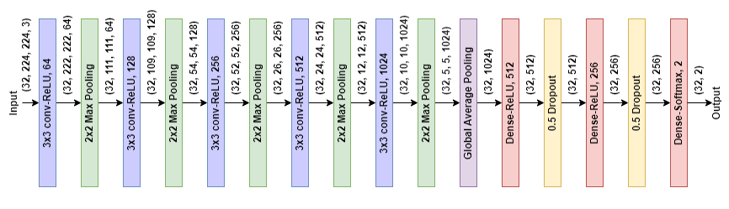
Methodology (Cont.)
Model Construction
(a)
(b)
Figure 7: Architecture of the Proposed CNN Models, (a) Model 1, (b) Model 2
17
Notes:
Drag & drop to add a picture in each placeholder

Slide 18
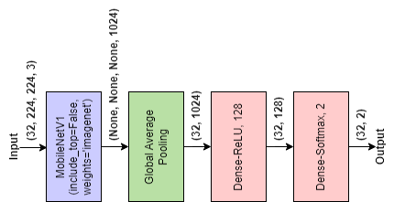
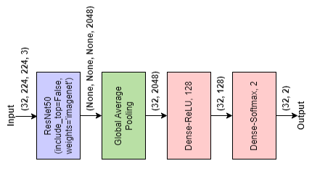
Methodology (Cont.)
Model Construction (Cont.)
(a)
(b)
Figure 8: Architectures of Transfer Learning Models, (a) MobileNetV1, (b) ResNet50
18
Notes:
Drag & drop to add a picture in each placeholder

Slide 19
Methodology (Cont.)
Model Compilation
Model Training
Optimizer: Adam (LR: 0.0001)
Loss Function: Sparse Categorical Cross-Entropy
Metric: Accuracy
Batch Size: 32 images
Epochs:
Proposed CNN Models: 80
Transfer Learning Models: 20
Saved best weights
Notes:
Drag & drop to add a picture in each placeholder

Slide 20
Environment Configuration
Platform: Google Colab
Resources:
12.7 GB RAM
15 GB GPU memory
78.2 GB disk space

Slide 21
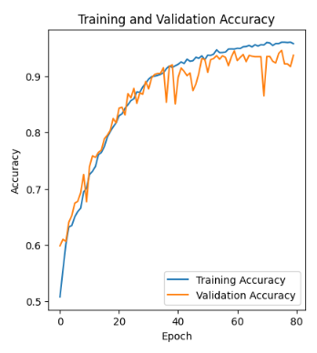
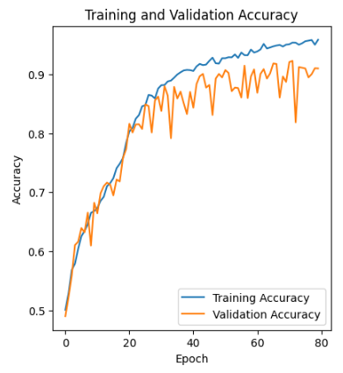
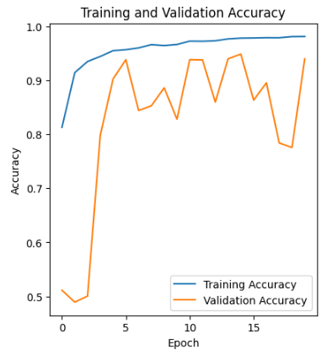
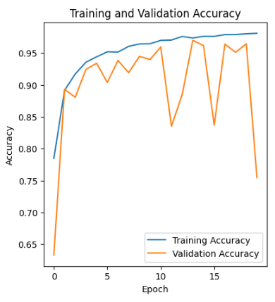
Performance Analysis
Accuracy and Loss Curves
(a)
(b)
(c)
(d)
Figure 9: Accuracy Curves of Models, (a) CNN1, (b) CNN2, (c) ResNet50, and (d) MobileNetV1
21
Notes:
Drag & drop to add a picture in each placeholder

Slide 22
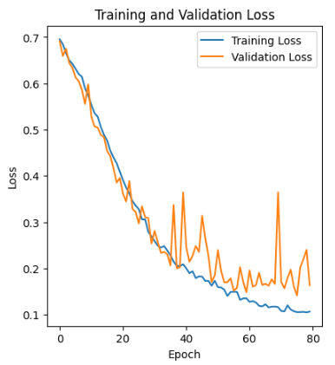
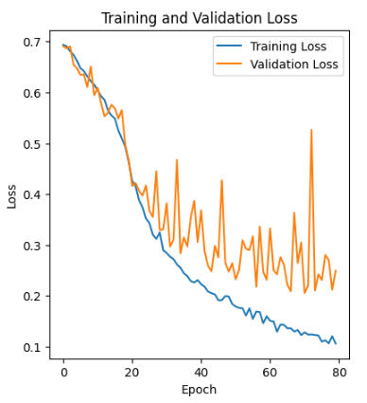
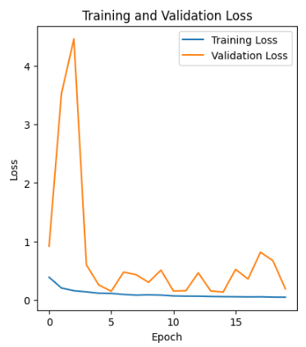
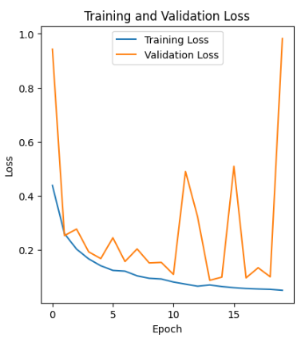
Performance Analysis (Cont.)
Accuracy and Loss Curves (Cont.)
(a)
(b)
(c)
(d)
Figure 10: Loss Curves of Models, (a) CNN1, (b) CNN2, (c) ResNet50, and (d) MobileNetV1
22
Notes:
Drag & drop to add a picture in each placeholder

Slide 23
Performance Analysis (Cont.)
Accuracy and Loss Curves (Cont.)
Table 2: Model’s performance in terms of accuracy and loss.
Model | Training Accuracy | Validation Accuracy | Training Loss | Validation Loss
CNN1 | 96% | 94.55% | 10.57% | 14.18%
CNN2 | 95.37% | 92.27% | 12.38% | 22%
ResNet50 | 97.58% | 96.19% | 6.22% | 10.85%
MobileNetV1 | 97.35% | 97% | 6.98% | 8.69%
23
Notes:
Drag & drop to add a picture in each placeholder

Slide 24
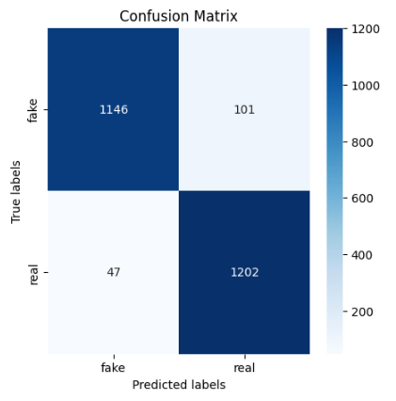
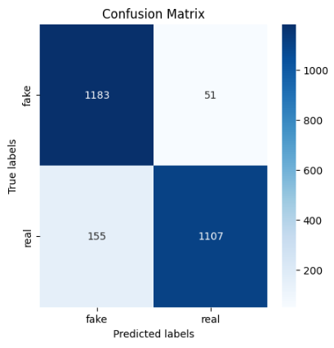
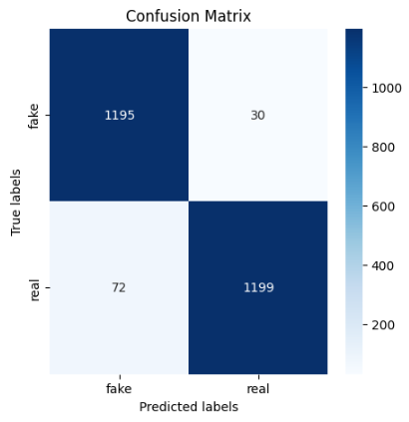
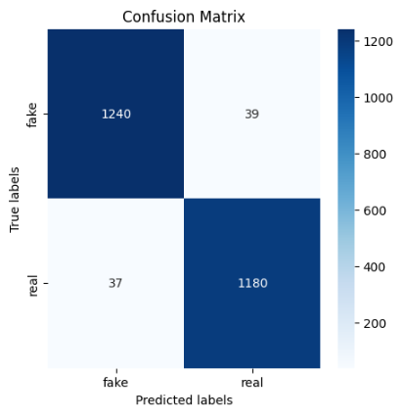
Performance Analysis (Cont.)
Confusion Matrices
(a)
(b)
(c)
(d)
Figure 11: Confusion Matrices of Models, (a) CNN1, (b) CNN2, (c) ResNet50, and (d) MobileNetV1
24
Notes:
Drag & drop to add a picture in each placeholder

Slide 25
Performance Analysis (Cont.)
Confusion Matrices (Cont.)
Table 3: Model’s performance in terms of precision, recall, F1 score, and test accuracy.
Model | Precision | Recall | F1 score | Test Accuracy
CNN1 | 96.06% | 91.90% | 93.93% | 94.07%
CNN2 | 88.42% | 95.87% | 91.99% | 91.75%
ResNet50 | 94.32% | 97.55% | 95.91% | 95.91%
MobileNetV1 | 97.10% | 96.95% | 97.03% | 96.96%
25
Notes:
Drag & drop to add a picture in each placeholder

Slide 26
Performance Analysis (Cont.)
Model Efficiency and Size Analysis
Table 4: Model’s Efficiency and Size.
Model | Image Size | Model Size | Total number of Parameters
CNN1 | 256 × 256 | 150.42 MB | 39.43 M
CNN2 | 256 × 256 | 26.43 MB | 6.93 M
ResNet50 | 256 × 256 | 90.98 MB | 23.85 M
MobileNetV1 | 256 × 256 | 12.82 MB | 3.36 M
26
Notes:
Drag & drop to add a picture in each placeholder

Slide 27
RESULT ANALYSIS
REAL IMAGE DETECTION
Correct Prediction
Wrong Prediction(False Positive)
Correct Prediction with Low Confidence
1. Clear Visibility of
Facial Features
Facial Angle
Occlusion
Unclear Facial Features
Crowding

Slide 28
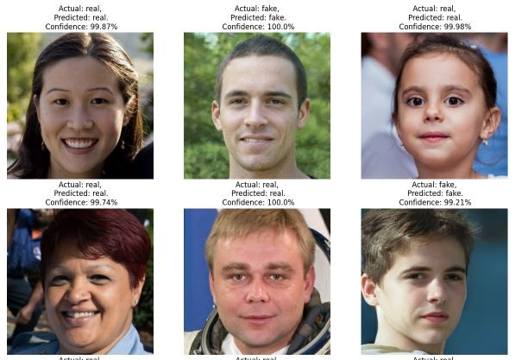
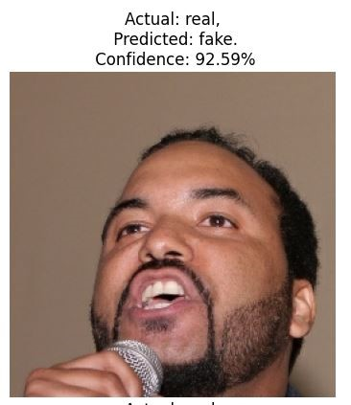
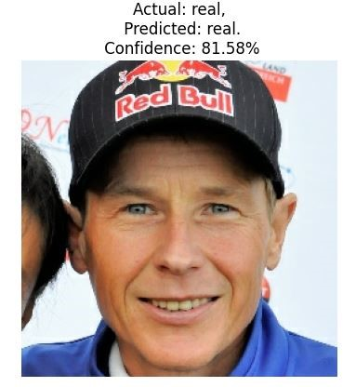
RESULT ANALYSIS
REAL IMAGE DETECTION
Figure 12: Correctly predicted Real Image
Figure 13: Incorrectly Predicted Real Image
Figure 14: Correctly Predicted Real Image with Low Confidence

Slide 29
RESULT ANALYSIS(Cont.)
FAKE IMAGE DETECTION
Correct Prediction
Wrong Prediction(False Negative)
Correct Prediction with Low Confidence
1. Background with Minor
Fault
Background Consistency Challenge
Occlusion
Unclear Facial Features

Slide 30
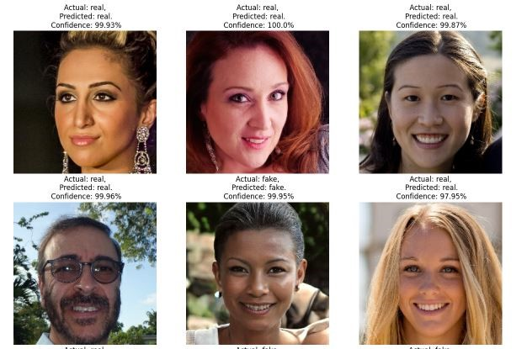
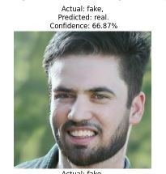
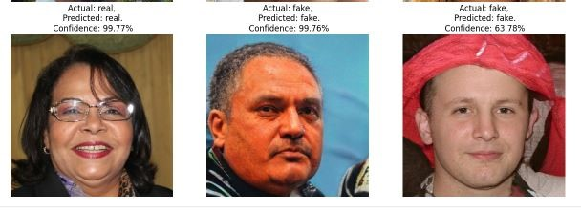
RESULT ANALYSIS(Cont.)
FAKE IMAGE DETECTION
Figure 15: Correctly predicted Fake Image
Figure 16: Incorrectly Predicted Fake Image
Figure 17: Correctly Predicted Fake Image with Low Confidence

Slide 31
VALIDATION TESTING
Table 5: Performance Comparison of proposed models, transfer learning models and model of referenced study on the 140k Real and Fake Faces Dataset
Model | Dataset | Test Accuracy
CNN1 | 140k Real and Fake Faces | 94.07%
CNN2 | 140k Real and Fake Faces | 91.75%
ResNet50 | 140k Real and Fake Faces | 95.91%
MobileNetV1 | 140k Real and Fake Faces | 96.96%
Challenges and Solutions in Deepfakes (Referenced Study) | 140k Real and Fake Faces | 94.41%
31
Notes:
Drag & drop to add a picture in each placeholder

Slide 32
VALIDATION TESTING(Cont.)
Table 6: Accuracy of Model 1, Model 2, Deep-CNN (D-CNN) architecture on StyleGAN Official TensorFlow Implementation
Model | StyleGAN
 | Psi 0.5 | Psi 0.7 | Psi 1.0
Proposed Model 1 | 91.71% | 82.54% | 66.23%
Proposed Model 2 | 90.57% | 84.50% | 71.45%
Deep-CNN (D-CNN) Architecture | 95.33%
32
Notes:
Drag & drop to add a picture in each placeholder

Slide 33
LIMITATIONS AND FUTURE WORKS
Limitations
Future Works
1. Limited Training Data Diversity
1. Enriching the Training Data
Landscape
2. Computational Resource
Constraints
2. Unlocking Computational Power
for Enhanced Training
3. Focus on Human Faces
3. Expanding Detection Beyond
Faces
4. Challenges in Identifying
Deepfakes
4. Refining Detection Techniques
for Complex Deepfakes
5. Limited Deepfake Type
Coverage
5. Enhancing Detection for Diverse
Deepfake Creation Methods

Slide 34
CONCLUSION
Deepfake detection is crucial for preventing misinformation and fraud. Our CNN models achieved over 90% accuracy in detecting StyleGAN images. In future, we'll expand our dataset and improve our methods to handle more diverse and complex deepfakes.
Notes:
Drag & drop to add a picture in the placeholder

Slide 35
THANK YOU
Notes:
Drag & drop to add a picture in the back placeholder

